Slide 1
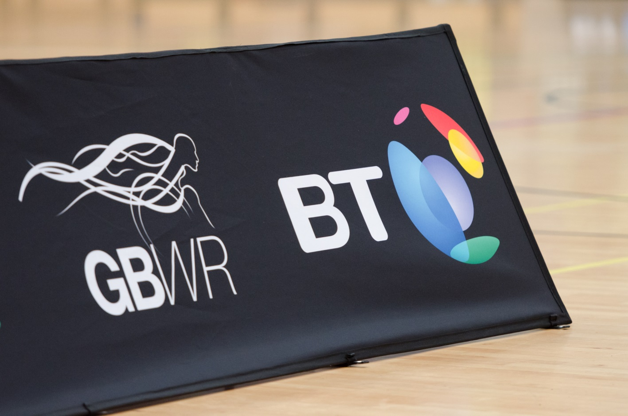
Domestic Season 2015-2016

Slide 2
Super Series
Division One:
28/29th Nov 2015 – Stoke Mandeville Stadium, Aylesbury
13/14th Feb 2016 – Fenton Manor Sports Complex, Stoke on Trent
2/3rd April 2016 – University of Wolverhampton, Walsall Sports Arena
Division Two:
7/8th Nov 2015 – Leicester DMU (this is provisional as ideally we want a bigger venue, TBC by 25^{/8/15)}
16/17th Jan 2015 – Fenton Manor Sports Complex. Stoke on Trent
9/10th April 2016 – Fenton Manor Sports Complex. Stoke on Trent
Division Three:
[Proposal: Single day competitions – Two in the North and Two in the South with One full weekend at the end]
North – Leigh Sports Village
6th Feb 2015
5th March
South - TBC
23rd Jan
20th or 27th Feb (TBC)
FINAL Weekend – Fenton Manor Sports Complex. Stoke on Trent
16th/17th April

Slide 3
Nationals
Proposed Date: 23rd – 24th April 2016
Venue: TBC
Design: TBC – Likely to be less teams
Nationals 2015 Feedback:
“Start of something great for the Nationals”
“The most important people in my life are my family and they couldn’t come to watch me due to cost”
“Great organisation by all – let down by empty venue”

